Slide 1
Recycling, Zero Waste and Energy Efficiency: A Sustainable Future
SÁNDOR KISS
UNIVERSITY OF NYÍREGYHÁZA / UNIVERSITY OF DEBRECEN

Slide 2
Why are these topics important?

Slide 3
A related term: Energy efficiency
Similar to the previous
Not just electricity 🡪 Heating
Main principles:
Using less
Conserving
Using the best technology available
What are the potential problems?

Slide 4
Why are these topics important?
Sustainability is crucial 🡪 Endless growth + consumption is not possible.
Healthy environment
Resource shortage
Economic necessity / Environmental necessity

Slide 5
Recycling
Benefits:
Fewer new resources needed
Reduces waste
Can be cost effective
Problems:
Can be expensive
Logistics
Participation + Eco-mindset

Slide 6
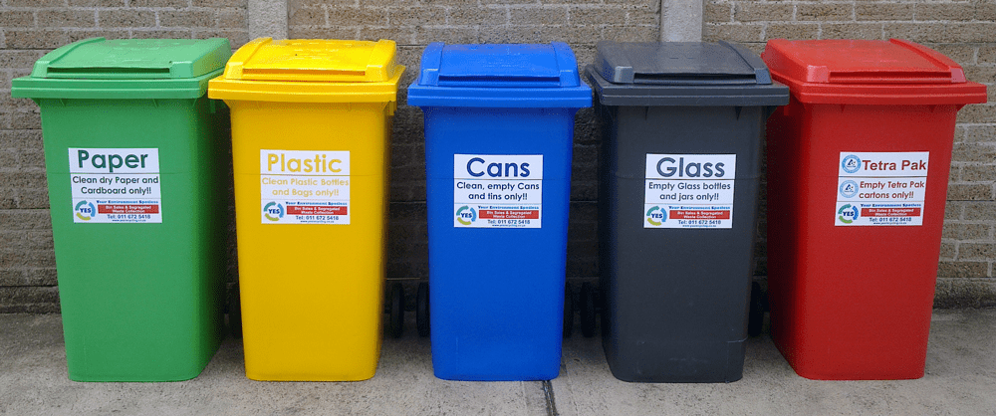
Recycling - Process
Steps
Collection
Sorting
Processing
Manufacturing
Challenges:
Lack of infrastructure
Contamination
Education + Awareness (Financial motivation?)

Slide 7
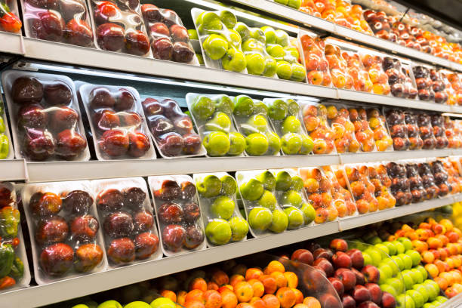
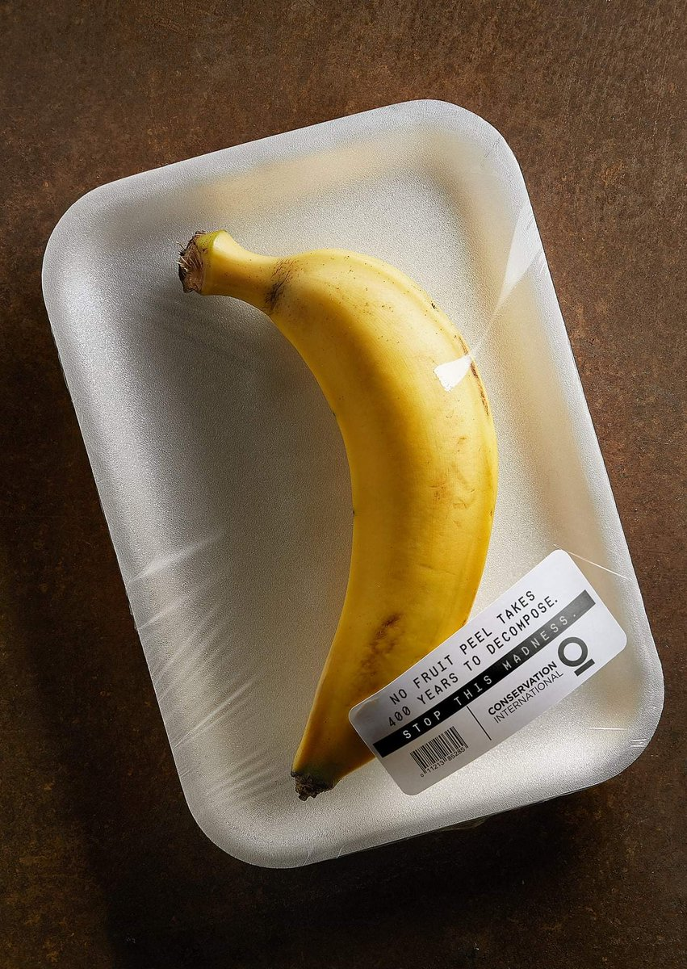
Zero waste approach
The best waste is no waste
Refuse
Reduce
Reuse
Recycle

Slide 8
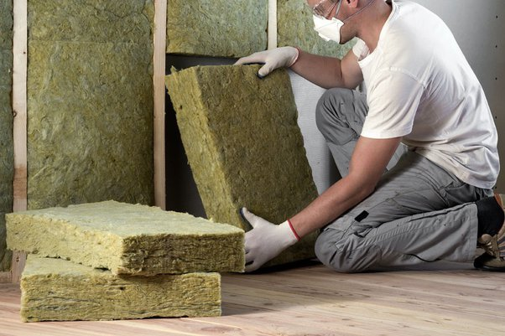
Technological examples
Energy efficiency in buildings: Insulation / HVAC systems (heating, ventillation, air conditioning)
Energy efficiency of household items

Slide 9
What do we do?
Training programs
Educational programs
Awareness weeks
Studies in Environmental Studies, Ecology, Geography, Biology etc.

Slide 10
What can you do?

Slide 11
Q&A

Slide 12
Thank you for your attention!

